Slide 1

Raspberry pi Python Basic’s
Lecturer: Reza Arjmandi
Summer 2016
Preface:
In this chapter, you will find a host of recipes to help you get programming with Raspberry Pi.

Slide 2
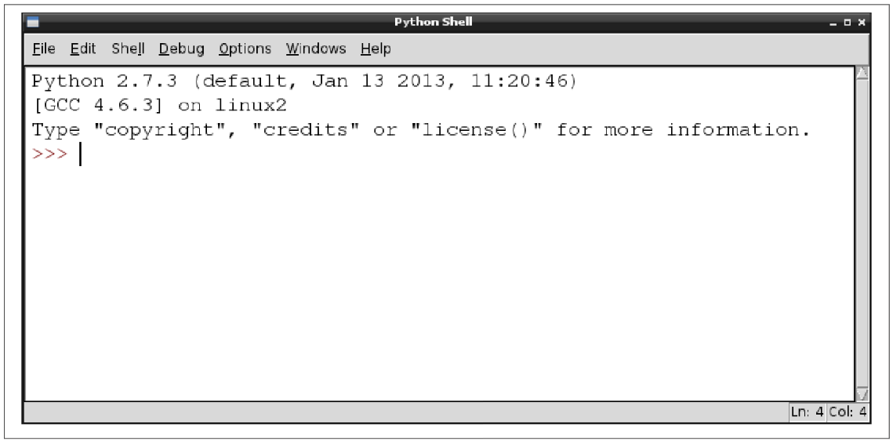
Editing Python Programs with IDLE
The common Raspberry Pi distributions come with the IDLE Python development tool in both the Python 2 and Python 3 versions. If you are using Raspbian , you will find shortcuts to both versions of IDLE on your Raspberry Pi desktop.
This is an interactive area where you can type Python and see the results immediately.

Slide 3
Indentation in Python
Whereas many C-based languages use { and } to delimit a block of code, Python uses the indentation level.
Example:
for i in range(1, 10):
print(i)
in the preceding example, Python knows that print is to be invoked repeatedly as part of the for loop because it is indented out four spaces.

Slide 4
Using the Python Console
You want to enter Python commands without writing a whole program.
Use the Python console, either within IDLE (Previous Recipe) or in a Terminal session.
To start a Python 2 console in a Terminal window, just type the command python; for a Python 3 console, enter the command python3.
The >>> prompt indicates that you can type Python commands. If you need to type multiline commands, then the console will automatically provide a continuation line indicated by three dots. You still need to indent any such lines, by four spaces, as shown in the following session:
>>> for i in range(1, 5):
... print(i)
...
1
2
3
4
5

Slide 5
Running Python Programs from the Terminal
Running programs from within IDLE is fine, but sometimes you want to run a Python program from a Terminal window.
Use the python or python3 command in a Terminal, followed by the filename containing the program you want to run.
Example:
$ python myprogram.py
You can run most Python programs as a normal user; however, there are some, especially those that use the GPIO port, that you need to run as super user.

Slide 6
Variables
Assign a value to a name using =.
In Python, you don’t have to declare the type of a variable, you can just assign it a value as shown in the following examples:
Example:
a = 123
b = 12.34
c = "Hello"
d = 'Hello'
e = True
You can define character string constants using either single or double quotes. The logical constants in Python are True and False and are case-sensitive.

Slide 7
Displaying Output
Use the print command. You can try the following example in the Python console
Example:
>>> x = 10
>>> print(x)
10
>>>

Slide 8
Reading User Input
Use the input (Python 3) or raw_input (Python 2) command. You can try the following example in the Python 3 console :
>>> x = input("Enter Value:")
Enter Value:23
>>> print(x)
23
>>>
Python 2 also has an input function, but this validates the input and attempts to convert it into a Python value of the appropriate type, whereas raw_input does the same thing as input in Python 3 and just returns a string.

Slide 9
Arithmetic
The most common operators for arithmetic are +, -, *, and /, which are, respectively, add, subtract, multiply, and divide.
You can also group parts of the expression together with parentheses, as shown in the following example:
>>> tempC = input("Enter temp in C: ")
Enter temp in C: 20
>>> tempF = (int(tempC) * 9) / 5 + 32
>>> print(tempF)
68.0
>>>
Other arithmetic operators include % (modulo remainder) and ** (raise to the power of). For example:
>>> 2 ** 8
256
The Math library has many useful math functions that you can use.

Slide 10
Creating Strings
Use the assignment operator and a string constant to create a new string. You can use either double or single quotation marks around the string, but they must match.
Example:
>>> s = "abc def"
>>> print(s)
abc def
>>>
If you need to include double or single quotes inside a string, then pick the type of quotes that you don’t want to use inside the string as the beginning and end markers of the string. For example:
>>> s = "Isn't it warm?"
>>> print(s)
Isn't it warm?
>>>

Slide 11
Creating Strings
Sometimes you’ll need to include special characters such as tab or newline inside your string. This requires the use of what are called escape characters. To include a tab, use \t, and for a newline, use \n. For example:
>>> s = "name\tage\nMatt\t14"
>>> print(s)
name age
Matt 14
>>>

Slide 12
Concatenating (Joining) Strings
Use the + (concatenate) operator.
Example:
>>> s1 = "abc"
>>> s2 = "def"
>>> s = s1 + s2
>>> print(s)
abcdef
>>>
In many languages, you can have a chain of values to concatenate, some of which are strings and some of which are other types such as numbers; numbers will automatically be converted into strings during the concatenation. This is not the case in Python, and if you try the following command, you will get an error:
>>> "abc" + 23
Traceback (most recent call last): File "<stdin>", line 1, in <module>
TypeError: Can't convert 'int' object to str implicitly

Slide 13
Concatenating (Joining) Strings
You need to convert each component that you want to concatenate to a string before concatenating, as shown in this example:
>>> "abc" + str(23)
'abc23'
>>>

Slide 14
Converting Numbers to Strings
Use the str Python function. For example:
>>> str(123)
'123'
>>>

Slide 15
Converting Strings to Numbers
Use the int or float Python function.
Example:
>>> int("-123")
-123
>>>
To convert a floating-point number, use float instead of int:
>>> float("123.45")
123.45
>>>

Slide 16
Converting Strings to Numbers
You can also use int to convert a string representing a number in a number base other than the default of 10 by supplying the number base as the second argument. The following example converts the string representation of binary 1001 into a number:
>>> int("1001", 2)
9
>>>
This second example converts the hexadecimal number AFF0 to an integer:
>>> int("AFF0", 16)
45040
>>>

Slide 17
Find the Length of a String
Use the len Python function.
For example, to find the length of the string abcdef, you would use:
>>> len("abcdef")
6
>>>
The len command also works on arrays

Slide 18
Find the Position of One String Inside Another
Use the find Python function.
For example, to find the starting position of the string def within the string abcdefghi, you would use:
>>> s = "abcdefghi"
>>> s.find("def")
3
>>>
If the string you’re looking for doesn’t exist in the string being searched, then find returns the value -1.

Slide 19
Extracting Part of a String
Use the Python [:] notation.
For example, to cut out a section from the second character to the fifth character of the string abcdefghi, you would use:
>>> s = "abcdefghi"
>>> s[1:5]
'bcde'
>>>
Note that the character positions start at 0, so a position of 1 means the second character in the string and 5 means the sixth, but the character range is exclusive at the high end, so the letter f is not included in this example.

Slide 20
Extracting Part of a String
The [:] notation is actually quite powerful. You can omit either argument, in which case, the start or end of the string is assumed as appropriate. For example:
>>> s = "abcdefghi"
>>> s[:5]
'abcde'
>>>
and
>>> s = "abcdefghi"
>>> s[3:]
'defghi'
>>>
You can also use negative indices to count back from the end of the string. This can be useful in situations such as when you want to find the three-letter extension of a file, as in the following example:
>>> "myfile.txt"[-3:]
'txt'

Slide 21
Replacing One String of Characters with Another Inside a String
Use the replace function.
For example, to replace all occurrences of X with times, you would use:
>>> s = "It was the best of X. It was the worst of X“
>>> s.replace("X", "times")
'It was the best of times. It was the worst of times'
>>>
The string being searched for must match exactly; that is, the search is case-sensitive and will include spaces.

Slide 22
Converting a String to Upper- or Lowercase
Use the upper or lower function as appropriate.
For example, to convert aBcDe to uppercase, you would use:
>>> "aBcDe".upper()
'ABCDE'
>>>
To convert it to lowercase, you would use:
>>> "aBcDe".lower()
'abcde'
>>>

Slide 23
Converting a String to Upper- or Lowercase
In common with most functions that manipulate a string in some way, upper and lower do not actually modify the string, but rather return a modified copy of the string.
For example, the following code returns a copy of the string s, but note how the original string is unchanged.
>>> s = "aBcDe"
>>> s.upper()
'ABCDE'
>>> s
'aBcDe'
>>>
If you want to change the value of s to be all uppercase, then you need to do the following:
>>> s = "aBcDe"
>>> s = s.upper()
>>> s
'ABCDE'

Slide 24
Running Commands Conditionally
Use the Python if command.
The following example will print the message x is big only if x has a value greater than 100:
>>> x = 101
>>> if x > 100:
... print("x is big")
...
x is big
After the if keyword, there is a condition. This condition often, but not always, compares two values and gives an answer that is either True or False. If it is True, then the subsequent indented lines will all be executed.

Slide 25
Running Commands Conditionally
It is quite common to want to do one thing if a condition is True and something different if the answer is False. In this case, the else command is used with if, as shown in this example:
x = 101
if x > 100:
print("x is big")
else:
print("x is small")
print("This will always print")
You can also chain together a long series of elif conditions. If any one of the conditions succeeds, then that block of code is executed, but none of the other conditions are tried. For example:
x = 90
if x > 100:
print("x is big")
elif x < 10:
print("x is small")
else:
print("x is medium")

Slide 26
Comparing Values
Use one of the comparison operators: <, >, <=, >=, ==, or !=.
Some people prefer to use the <> operator in place of !=. Both work the same
You can test out these commands using the Python console , as shown in the following exchange:
>>> 1 != 2
True
>>> 1 != 1
False
>>> 10 >= 10
True
>>> 10 >= 11
False
>>> 10 == 10
True
>>>

Slide 27
Comparing Values
A common mistake is to use = (set a value) instead of == (double equals) in comparisons.
As well as comparing numbers, you can also compare strings using these comparison operators, for example:
>>> 'aa' < 'ab'
True
>>> 'aaa' < 'aa'
False
The strings are compared lexicographically—that is, in the order that you would find them in a dictionary.
This is not quite correct as, for each letter, the uppercase version of the letter is considered less than the lowercase equivalent.

Slide 28
Logical Operators
You need to specify a complex condition in an if statement.
Use one of the logical operators: and, or, and not.
Example:
>>> x = 17
>>> if x >= 10 and x <= 20:
... print('x is in the middle')
...
x is in the middle

Slide 29
Repeating Instructions an Exact Number of Times
Use the Python for command and iterate over a range.
For example, to repeat a command 10 times, use the following example:
>>> for i in range(1, 11):
... print(i)
...
1
2
3
4
5
6
7
8
9
10
>>>

Slide 30
Repeating Instructions Until Some Condition Changes
Use the Python for command and iterate over a range.
Use the Python while statement. The while statement repeats its nested commands until its condition becomes false. The following example will stay in the loop until the user enters X for exit:
>>> answer = ''
>>> while answer != 'X':
... answer = input('Enter command:')
...
Enter command:A
Enter command:B
Enter command:X
>>>

Slide 31
Breaking Out of a Loop
Use the Python break statement to exit either a while or for loop
Example:
>>> while True:
... answer = input('Enter command:')
... if answer == 'X':
... break
...
Enter command:A
Enter command:B
Enter command:X
>>>

Slide 32
Defining a Function in Python
Create a function that groups together lines of code, allowing it to be called from multiple places.
Creating and then calling function in Python is illustrated in the following example:
def count_to_10():
for i in range(1, 11):
print(i)
count_to_10()
The example function is a little inflexible because it can only count to 10. If we wanted to make it more flexible—so it could count up to any number—then we can include the maximum number as a parameter to the function, as this example illustrates:
def count_to_n(n):
for i in range(1, n + 1):
print(i)
count_to_n(5)

Slide 33
Defining a Function in Python
You can specify a default value for a parameter, and hence have the best of both worlds, as shown in this example:
def count_to_n(n=10):
for i in range(1, n + 1):
print(i)
count_to_n()
If your function needs more than one parameter, perhaps to count between two numbers, then the parameters are separated by commas:
def count(from_num=1, to_num=10):
for i in range(from_num, to_num + 1):
print(i)
count()
count(5)
count(5, 30)

Slide 34
Defining a Function in Python
If you need a function to return a value, you need to use the return command.
def make_polite(sentence):
return sentence + " please“
print(make_polite("Pass the cheese"))

Slide 35


Contact us
www.e-system.ir
Info@e-system.ir

